Slide 1


ILLINOIS MEDICAL RESPITE NETWORK
Medical Respite
in Illinois
A Journey to Recovery with Dignity
HEALTHY RECOVERY REQUIRES RESPITE

Slide 2
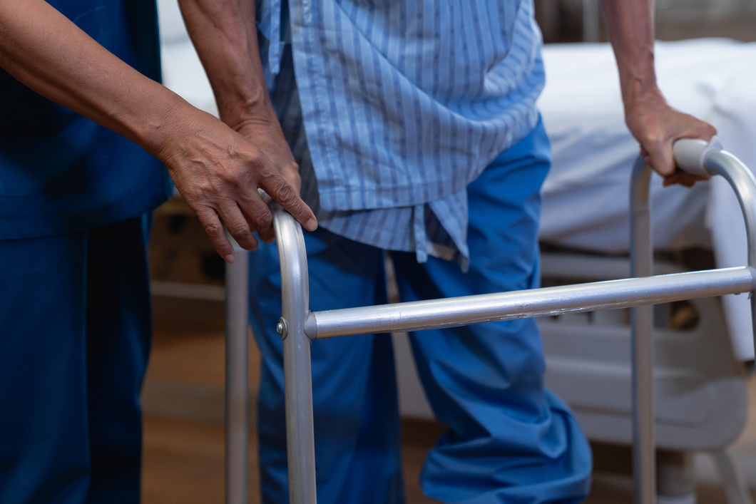
1. The Purpose
What is medical respite care?

Slide 3

Introduction
What is Medical Respite?
Medical respite care is short-term, post-acute care for people experiencing homelessness who need a safe, supportive place to recover, but do not require continued hospitalization.
Medical respite care helps hospitals discharge patients safely and efficiently, reduce preventable readmissions, and improve recovery outcomes.
Notes:
(Add a description of your medical respite program if needed. Add your program logo and/or information to the purple box on each slide)

Slide 4

In Short…
What is Medical Respite?
Medical respite care supports recovery, stability, and dignity for people who may not otherwise have a safe place to heal.

Slide 5
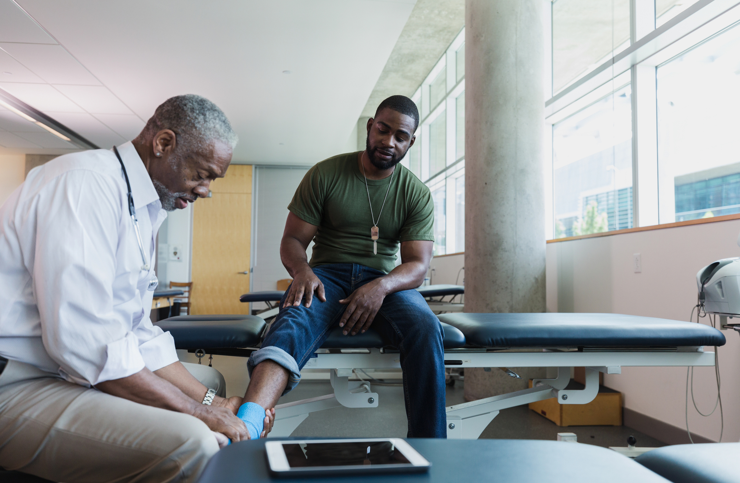
The Importance
Medical Respite Can:
  Medical respite care may support people recovering after illness, injury, surgery, hospitalization, or while preparing for surgery. It helps patients stay connected to follow-up care, connects them with health, housing, and community supports, and can reduce avoidable discharge barriers and hospital readmissions.
Notes:
Medical respite care may support people recovering after illness, injury, surgery, hospitalization, or pre-operative care.

Slide 6

2. The People
Who does medical respite serve?
Notes:
(Add program specific eligibility details as necessary)

Slide 7
Medical respite may be appropriate when a patient:
  Is experiencing homelessness or does not have a safe, stable place to recover
  Has an acute medical need or a medical need connected to a chronic condition
  No longer requires inpatient hospital care
  Needs pre-operative care or short-term recovery support after illness, injury, surgery or hospitalization
  Can manage activities of daily living independently, including bathing, transferring and toileting
  Has a primary medical need, even if secondary mental health or substance use conditions are present and stable enough to safely participate in recovery care
When is medical respite appropriate?
Notes:
(Add program specific eligibility details as necessary)

Slide 8
Please Note:
  Final eligibility and acceptance are determined by each medical respite program based on the individual’s needs, program criteria, available capacity, staffing model and services.
When is medical respite appropriate?
Notes:
(Add program specific eligibility details as necessary)

Slide 9
Another setting or support may be more appropriate when a patient:
  Does not have an acute or post-acute medical need
  Has a stable chronic condition without a current medical recovery need
  Still requires hospital-level care
  Needs nursing home-level care, inpatient rehabilitation or a higher level of medical supervision
  Cannot independently manage key activities of daily living
  Has active suicidal or homicidal ideation requiring immediate crisis intervention
  Has active, untreated or unmanaged mental health needs that cannot be safely supported in the medical respite setting
  Has complex medical needs that exceed the program’s staffing, space or service model
When is another setting or support more appropriate?
Notes:
Emphasize:
This is not long-term housing ​
Patients still receive medical oversight ​
Programs are staffed and structured
“What happens next for these patients?” → Medical respite programs help connect them to resources to manage their current and chronic health conditions and support the next steps into long term stability like housing and food access.

Slide 10
Please Note:
  A patient who is not accepted by one medical respite program may still be appropriate for another medical respite program with a different care model, staffing structure, or available capacity.
When is another setting or support more appropriate?

Slide 11
Medical respite may be appropriate
A patient without stable housing is being discharged with ongoing wound care needs, such as dressing changes after frostbite, cellulitis, a post-operative wound or another acute condition. The patient is medically stable but needs medication support and follow-up appointments.
Why?
The patient no longer needs to remain in the hospital but still needs short-term recovery support and help connecting to care.
Example 1
Notes:
(Edit these examples with local scenarios that reflect the care model more appropriately.)

Slide 12
Medical respite may be appropriate
A patient experiencing homelessness is hospitalized after a chronic obstructive pulmonary disease (COPD) exacerbation. The patient usually manages medications independently but needs a safe place to recover, use an oxygen concentrator, and store oxygen tanks.
Why?
The current hospitalization created an acute recovery need connected to a chronic condition that can be supported in medical respite.
Example 2
Notes:
(Edit these examples with local scenarios that reflect the care model more appropriately.)

Slide 13
Another setting or support may be more appropriate
A patient is not medically ready for discharge or needs 24-hour skilled nursing care, inpatient monitoring or a higher level of medical supervision.
Why?
Medical respite programs are not licensed healthcare facilities and may not be able to support needs that require hospital-level or nursing home-level care.
Example 3
Notes:
(Edit these examples with local scenarios that reflect the care model more appropriately.)

Slide 14
3. The Programs
What does medical respite provide?
Notes:
(Add program specific eligibility details as necessary)

Slide 15
Services vary by medical respite program, but may include:
  Medication support
  Wound care support
  Care coordination
  Follow-up appointment coordination
  Transportation support
  Connections to behavioral health, housing and community services
  Support planning for next steps after the respite stay
Common services and supports
Notes:
(Add services provided or not provided by your own program)

Slide 16
Medical respite programs can support referral partners by helping address discharge barriers for patients who do not have a safe, stable place to recover.
Common services and supports
Notes:
(Add services provided or not provided by your own program)

Slide 17
4. The Process
Understanding Medical Respite Referrals
Notes:
(Add program specific eligibility details as necessary)

Slide 18
Referral partners may be asked to:
  Review program eligibility and contact information
  Submit referral information through the approved pathway
  Submit referral packet with clinical summary, active medication list, screening for known active risk and any relevant PT/OT notes
  Support completion of the medical insurance process
  Provide at least a 14–30-day medication supply
  Arrange transportation before discharge
When and
How to Refer
Notes:
Possible additions:
“Medical respite programs aim to provide an acceptance or denial within 48 hours of referral.”
(Add program referral link, referral contact information, required documentation)

Slide 19
Referral processes vary by medical respite program. Referral partners should contact the appropriate medical respite program to confirm requirements, capacity and next steps.
The Referral
Process
Notes:
(Add services provided or not provided by your own program)

Slide 20
Please Note:
Referral partners are encouraged to submit referrals even if a program is at capacity. Availability may change, or a patient may be added to a waitlist.
A denial at one medical respite program does not necessarily mean denial at all programs. Another location may be a better fit based on the person’s needs and the program model.
Referral Process Notes
Notes:
(Revise as needed)

Slide 21
Referral partners can support this work by:
  Identifying patients who may be appropriate for medical respite
  Understanding referral requirements and program capacity
  Sharing complete referral information
  Building medical respite into discharge planning workflows when applicable
  Maintaining communication with local medical respite programs
Referral Partner Role

Slide 22

5. The Partners
Shared Benefits & Next Steps
Notes:
(Add program specific eligibility details as necessary)

Slide 23
Medical respite can help referral partners by:
  Providing a safe discharge option, when appropriate
  Reducing avoidable hospital readmissions
  Preventing health conditions from escalating to ER visits
  Reducing unnecessary inpatient length of stay
  Increasing engagement with outpatient care
  Connecting patients to long-term supports and follow-up care
  Strengthening coordination across healthcare and community partners
How Medical Respite Supports Referral Partners
Notes:
“Hospitals often face difficult discharge decisions when patients lack stable housing, leading to longer stays, delayed discharges due to lack of safe placement, frequent preventable re-admissions, and strains on bed capacity. Medical respite can help referral partners with these challenges by… (read from list on slide)”
“By reducing avoidable hospital days and readmissions, medical respite care can lower costs while freeing up critical bed space.”​
Feel free to tailor to audience and noted priorities in internal comms capacity training slide deck

Slide 24
Medical respite is a safe discharge option that helps patients recover outside the hospital while reducing readmissions and easing discharge pressure.
In Summary
Notes:
(Add services provided or not provided by your own program)
Strong partnerships can support recovery, continuity of care and long-term stability for people experiencing homelessness.

Slide 25
After this presentation, partners can:
  Review:
    Medical Respite Info Sheets
    IllinoisMedicalRespite.org
  Contact Us
    ADD IN PROGRAM CONTACT INFO
  Begin using the referral process when an appropriate patient is identified
Next steps
Notes:
(Add program contact in the space below “next steps”)
Feel free to add in a better description for your own program’s first step in using the referral process

Slide 26

Closing
Medical respite works best when healthcare and community partners come together to disrupt the cycles of homelessness.
By improving care transitions, supporting recovery, and connecting people to housing and ongoing care, medical respite can help facilitate better outcomes for patients, strengthen communities, and help healthcare systems deliver more effective, coordinated care.

