Slide 1



IPHI · MEDICAL RESPITE PROGRAM
Medical Respite Communication Training Guide
How to Engage Hospital Teams and Decision-Makers
PLAN DIFFERENTLY. HEAL DIFFERENTLY.

Slide 2

Section 1:
Introduction

Slide 3
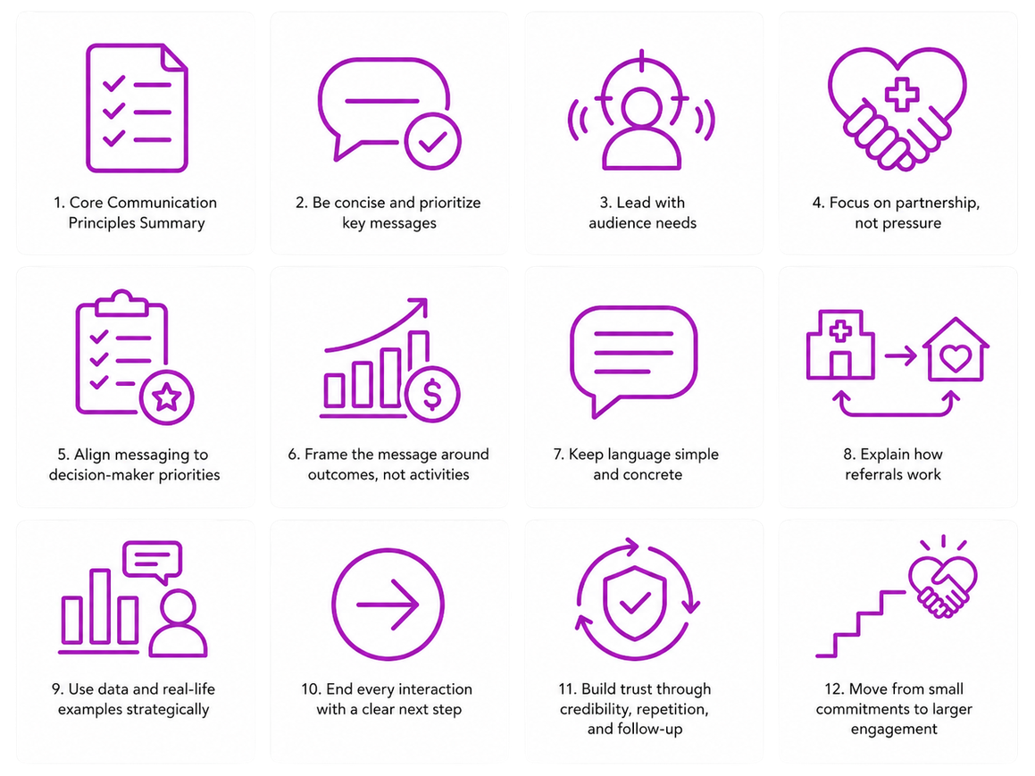
Medical respite care programs often face challenges when connecting with hospital providers and decision-makers—not because the programs lack value, but because the message doesn’t always align with hospital priorities. This guide is designed to support partners in having clearer, more effective, introductory conversations with hospital staff. It translates key communication strategies into practical, real-world approaches that improve understanding, build trust, and increase respite care referrals. At its core, this guide is about how people process information, make decisions, and take action in a hospital environment.
Core Communication Principles Summary
All successful engagement strategies in this guide are grounded in the following principles:
1. Be concise and prioritize key messages.
2. Lead with audience needs.
3. Focus on partnership, not pressure.
4. Align messaging to decision-maker priorities.
5. Frame the message around outcomes, not activities.
6. Keep language simple and concrete, not conceptual.
7. Use data and real-life examples strategically.
8. End every interaction with a clear next step.
9. Build trust through credibility, repetition, and follow-up. 10. Move from small commitments to larger engagement.

Slide 4

Section 2:
Building the Foundation with Effective Communication

Slide 5
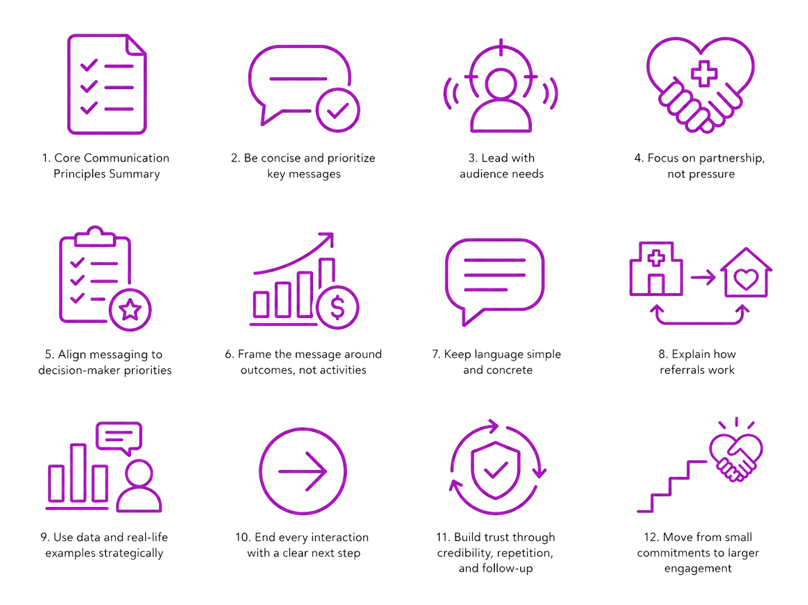
Be concise and prioritize key messages. Start with a clear, audience-first, one-sentence definition.
Goal: immediately eliminate confusion. Provide a simple, plain-language explanation of medical respite care.
  Suggested structure: “Medical respite care is short-term, post-acute care for patients experiencing homelessness who still need a safe, supportive place to recover, but do not require continued hospitalization.”
  Length: 1–2 sentences max.
  Tip: avoid jargon like “continuum of care” upfront—clarity wins first.
  Pitch: “Medical respite care provides short-term recovery for patients experiencing homelessness who don’t need hospitalization but still need support to recover safely after discharge. It helps hospitals discharge patients safely, reduce readmissions, and improve recovery outcomes.”
Examples:
  “Medical respite care is short-term medical recovery for patients experiencing homelessness still need a safe, supportive place to recover, but not sick enough to remain in the hospital.”
  “It’s a safe discharge option that helps patients recover outside the hospital while reducing readmissions and easing discharge pressure.”

Slide 6

Lead with audience needs. Define the problem you’re solving (why this matters)
Goal: Make it clear to hospitals that you understand their
discharge challenges.
  Frame this in terms of challenges hospitals already face:
    Delayed discharges due to lack of safe placement
    Frequent re-admissions among patients experiencing homelessness
    Strains on bed capacity
    Discharge planning barriers
  Suggested framing: “Hospitals often face difficult discharge decisions when patients lack stable housing, leading to longer stays or preventable readmissions.”
  Length: 2–4 sentences.
  Tip: this section should feel like “you get it.”
Example:
  “Hospitals often struggle with safe discharge when patients don’t have stable housing. This can lead to longer stays and avoidable readmissions.”

Slide 7
Focus on partnership, not pressure. Introduce medical respite as the solution.
Goal: Position medical respite as a direct answer to
those problems.
  Connect explicitly back to the challenges:
    Safe discharge option
    Continued medical oversight
    Care coordination + social services
  Length: 2–3 sentences
  Tip: Lead with hospital priorities not your program - “don’t start with what we do, start with what they’re dealing with.”
  Core idea:
    Hospital teams are often focused on patient flow, safe discharge, readmissions and outcomes.
    Start with current obstacles: discharge delays, readmissions, bed shortages
    Then introduce the solution: Medical respite
  Tip: Use the “problem → solution → outcome” framework: structure builds persuasion - every conversation should clearly connect problem to outcome.
  Why this works: People engage when they feel understood and when information is relevant to their priorities. This is rooted in audience-centered communication and behavior change theory. In practice, lead with their challenges, not your program. Start with hospital pain points (discharge delays, readmissions), then frame everything in terms of how medical respite helps them.
  Simple flow:
    Problem hospitals face
    How respite solves it
    What improves as a result
  Example: “Hospitals are challenged by delays in discharging patients due to lack of safe placement. As a result, there is an increase in patient readmissions and added strain put on hospital resources, like bed capacity and care coordination. Medical respite programs provide a safe, supervised environment where patients can recover while accessing medical care and support services, helping hospitals discharge patients safely and efficiently.”

Slide 8
Align messaging to decision-maker priorities. Highlight targeted benefits (what hospital audiences need to hear).
Goal: appeal to audience’s quality priorities.
  Include outcomes like:
    Transition to long term stability
    Reduced readmission rates – indicates successful recovery
    Increased utilization of outpatient services – indicates connection to follow up/chronic care management to avoid readmission
      Note: Both 2 & 3 lead to cost savings
  Length: 2–4 sentences or 3–5 bullets
  Tip: Before starting a conversation, take a moment to identify your audience. Adjusting your message to match their priorities increases understanding, trust, and follow-through.
    i. Core idea: Clinicians, case managers, and executives each listening for different priorities.
      Clinicians: patient outcomes, continuity of care
      Case managers/discharge planners: logistics, eligibility, ease of referral
      Executives: cost, efficiency, system impact
  Why this works: Decision-makers filter everything through value and impact. Tailor your message to each audience type and emphasize benefits that match their role (clinicians: patient outcomes, administrators: cost & efficiency, staff: ease of workflow).
  Examples:
    Clinicians:
      “Supports recovery after discharge”
      “Reduces risk of complications”
      “Maintains continuity of care”
      “Improves patient stability post-hospitalization”
    Case managers/discharge planners
      “Another discharge option”
      “Straightforward referral process”
      “We help determine eligibility”
      “Reliable placement when options are limited”
    Executives:
      “Reduces length of stay”
      “Improves bed utilization”
      “Lowers avoidable costs”
      “Supports efficient patient flow”

Slide 9
Frame the message around outcomes, not activities. Emphasize cost & operational impact (why decision-makers care)
Goal: speak to administrators, finance teams, and leadership.
  Include:
    Reduced length of stay
    Lower readmission rates
    Cost savings per patient
    Better bed utilization
  Suggested framing: “By reducing avoidable hospital days and readmissions, medical respite care can lower costs while freeing up critical bed space.”
  Length: 2–4 sentences
  Tip: Position this message as a partnership, not a pitch - collaboration language builds trust faster than persuasion language.
    Use language like: “we support your discharge process” or “we partner with your care teams”
    Avoid: “you should use our program”
  Why this works: The Framing Effect - The way information is presented influences how it’s perceived. Instead of: “We provide services to unhoused individuals,” try: “We help hospitals safely discharge patients and reduce readmissions.” Remember: Frame the message around outcomes, not activities.
  Examples:
    We help hospitals discharge patients safely.
    We help reduce readmissions and avoid bed use.
    We provide a structured place to recover with medical support.

Slide 10

Section 3:
Making Programs Easy to Understand and Use

Slide 11
Keep language simple and concrete, not complex and conceptual.
Explain how referrals work (make it clear and actionable).
Goal: Remove friction and uncertainty.
  Answer the following:
    Who qualifies?
    When should referral partners consider referrals?
    How does the referral process work?
  Length: 3–5 bullets or short sentences
  Tip: make the referral process sound easy. If this feels complicated, providers won’t follow through—keep it simple. Clarity + simplicity = actual referrals.
    Emphasize simplicity
    Repeat key steps
    Offer support
  Why this works: Cognitive load theory - People can only process a limited amount of information at once, especially in high-stress environments like hospitals. Clarity beats complexity every time. This shows up as simple definitions, clear referral steps, and concise, high-impact data.
  Example: A discharge case manager learns that the patient, who is ready for discharge, is experiencing homelessness. The case manager refers to the Illinois Medical Respite Network Guide to find a local medical respite provider that aligns with program eligibility requirements. The case manager reaches out to a program via the contact or referral link provided on their profile.

Slide 12
Use data and real-life examples strategically. Address common misconceptions by pairing them with success stories.
Goal: Address common questions before they become barriers.
  Examples:
    “This is not long-term housing”
    “Patients still receive medical oversight”
    “Programs are staffed and structured”
  Length: 2–3 quick clarifications
  Tip: Normalize hesitations from your audience – address the concerns so they don’t become silent barriers, and pair it with examples of success!
  Why this works: Social proof & credibility – people trust what others are already doing successfully. Mentioning partnerships with other organizations or hospitals and sharing their outcomes and success stories builds trust in the potential for success.
  Examples:
    “Is this housing?” → No, it’s short-term medical recovery
    “Who manages care?” → Medical oversight + coordination provided
    “What happens next for these patients?” -> Medical respite programs help connect them to resources to manage their current and chronic health conditions and support the next steps into long term stability like housing and food access

Slide 13

Section 4:
Building Trust and Encouraging Adoption

Slide 14
End every interaction with a clear next step. State a clear call to action.
Goal: Tell them exactly what to do next.
  Examples:
    “Contact our team to discuss partnership opportunities”
    “Refer eligible patients through [process]”
    “Schedule a brief info session”
  Length: 1–2 sentences
  Tip: End every conversation with a clear next step – having an unclear ask results in no follow through. Start small; make it easy to say yes.
  Why this works: The “foot-in-the-door” technique – This is a well-established behavioral science principle that shows that people are more likely to agree to bigger actions after saying yes to smaller ones. Then build toward referrals and partnerships.
  Examples:
    “Can I send more information?”
    “Who handles discharge planning referrals?”
    “Would a quick 10-minute overview be helpful?”
    “What would be the best next step to explore this further?”

Slide 15

Build trust through credibility, repetition, and follow-up. Add a memorable data point or story.
Goal: Make it stick emotionally and logically. One compelling stat or one short patient outcome example
  Length: 1–3 sentences
  Tip: Pair data with a human example. Data convinces the brain, but stories stick with people. Make it real, not just measurable.
  Example:
    Short, anonymized patient scenario
    Show before → after impact

Slide 16

Move from small commitments to larger engagement. Close with repetition and tie it all together.
Goal: Leverage benefits that build toward deeper engagement over time. Reinforce key messages consistently (what medical respite is, who qualifies, and how to refer) so partners gain confidence and are more likely to act.
  Length: 1-2 sentences
  Examples:
    “Medical respite care provides a safe, short-term recovery option for patients experiencing homelessness who are not yet ready for discharge without support. Is there someone on your team who would be the right point of contact for ongoing referrals?”
    “Medical respite care supports safe discharge and continuity of care by offering medically supported recovery outside the hospital for patients still need a safe, supportive place to recover. Would your team benefit from a short training on eligibility and the referral process?”
    “Medical respite care helps hospitals improve discharge flow and reduce avoidable readmissions by providing a reliable step-down option for patients without safe – replace with “stable” housing. What would it take to formalize a referral pathway between our teams?”

Slide 17

Closing
Medical respite care is a highly impactful intervention—but its success depends not only on what it offers, but on how clearly and effectively it is communicated to hospital partners. This guide is intended to support consistent, confident, and strategic communication that strengthens partnerships and improves patient outcomes.

